Slide 1
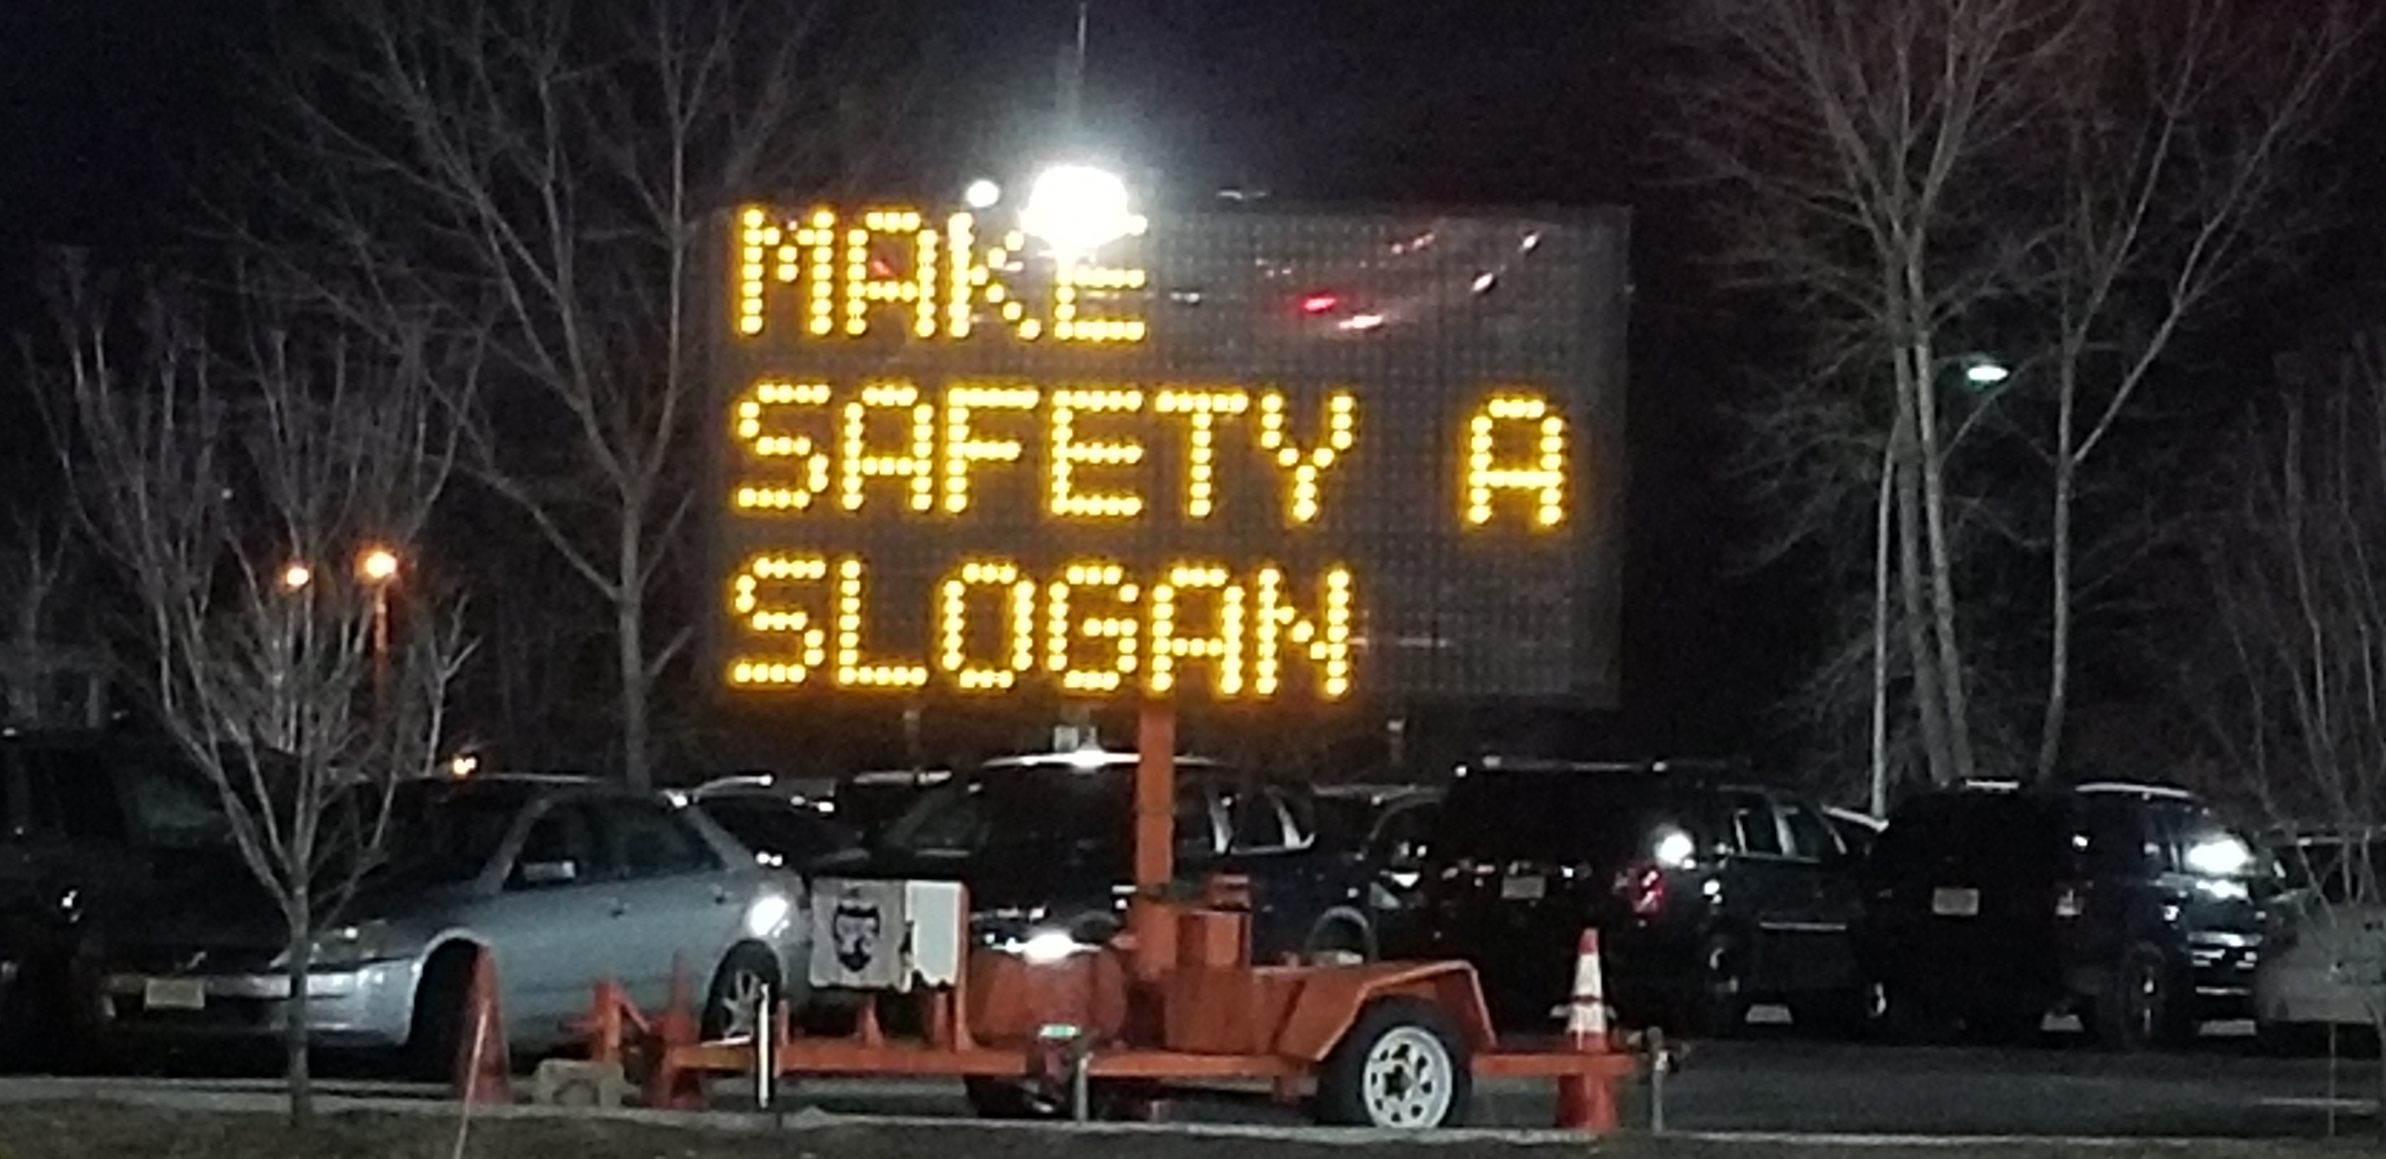
2019 NIFA Safety Discussion

Slide 2
Welcome & Introductions
Taylor Newman, NIFA Executive Director
Andrew Ross, SAFECON 2019 Chief Judge
Greg Weseman, SAFECON 2019 Associate Chief Judge
Erich Hess, NIFA Senior Chief Judge

Slide 3
Meeting Agenda
Code of Conduct
Highlight new procedures
Review where to find information
Discuss safety considerations
Review Landing Events penalties

Slide 4
NIFA Code of Conduct
Safety
Paramount
Professionalism
Dress, manner, respect, language
Teamwork
Some smaller teams may need help
Protest Procedures
Through coach/advisor, then to Chief Judge
Never appropriate for contestant to directly challenge a Judge

Slide 5
Communication
Twitter
Follow @SAFECONChief
Website
All information is at safecon.nifa.aero
Twitter will only advise of an update
Questions
Ask through E-Comm Desk if possible
Our contact information is on the website
Advisors make sure we have current and correct contact information for someone who is here in Janesville

Slide 6
Schedule
Flexibility
Changing appointments if/when changes happen
Please be early

Slide 7
Chief & Assoc. Chief Judge

Slide 8
Score vs. Safety
Yes, this is a competition, but safety is paramount
Cannot afford a mishap
Decision making
Landings
Traffic pattern alertness
Go-around v. out of the box
Navigation
Message Drop
Not bad pilots, some just make poor decisions

Slide 9
Landing Penalty Review

Slide 10
Landing Penalty Review
Updated landing penalties on website
Collecting data through the electronic landing cards
Analyze data for trends
Compare 2017 and 2018 data

Slide 11
Definitions
School Tiers:
Tier A: 1st through 3rd place overall
Tier B: 4th through 10th place overall
Tier C: 10th place through last overall
High Point Penalty
Any penalty >100 points
Additional emphasis on 400 point penalties
Considerations
Disproportionate number of contestants in each tier can skew results when looking at “average by contestant” numbers
Only flew 4 heats in 2018 versus all 5 heats in 2017

Slide 12
High Point Penalties – All Events

Slide 13
High Point Penalties – All Events (Normalized)

Slide 14
High Point Penalties by School Tier (Normalized)

Slide 15
Disqualifications

Slide 16
2018 Trends

Slide 17
2018 Trends

Slide 18
Conclusion
Continue to work on improving safety in the landing events, we are generally holding steady with some areas of improvement
Safety throughout the week
Flexibility as schedule changes arise
Any questions?

Slide 19
Thank you!

